Slide 1
School Timetables 2023/24
Notes:
NOTE: To change images on this slide, select a picture and delete it. Then click the Insert Picture icon
in the placeholder to insert your own image.

Slide 2
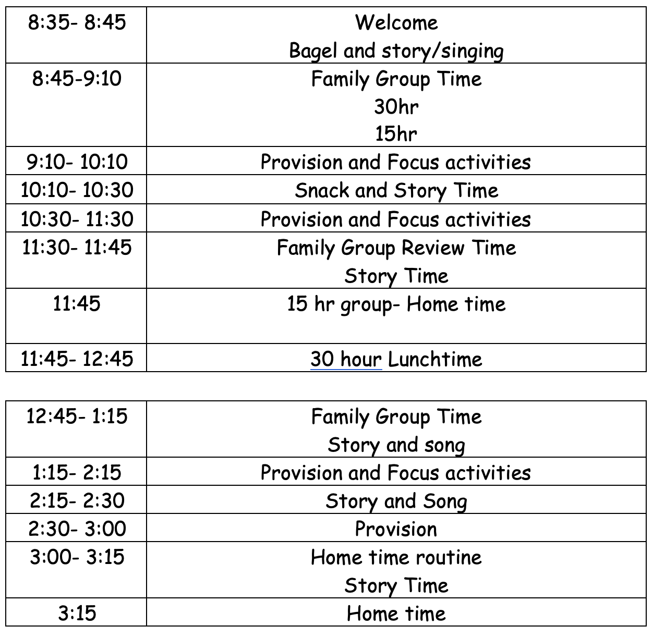
Nursery Timetable

Slide 3
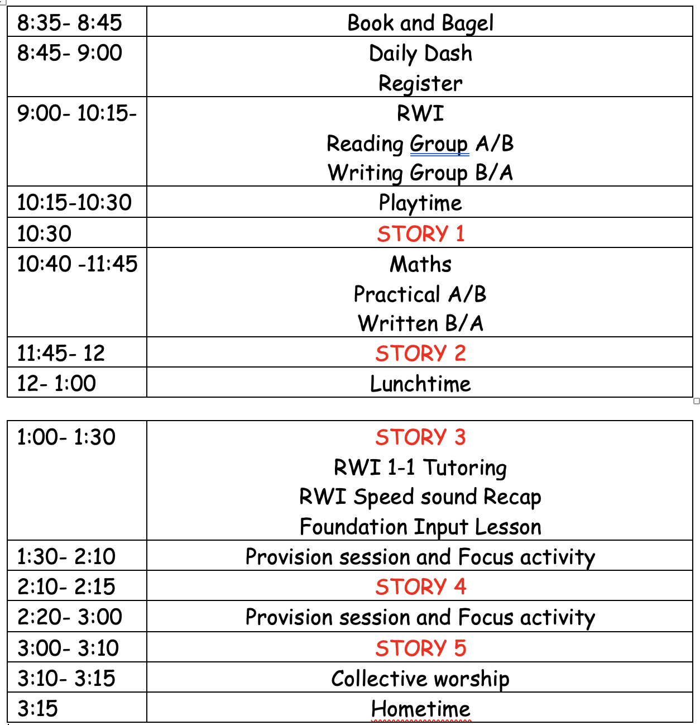
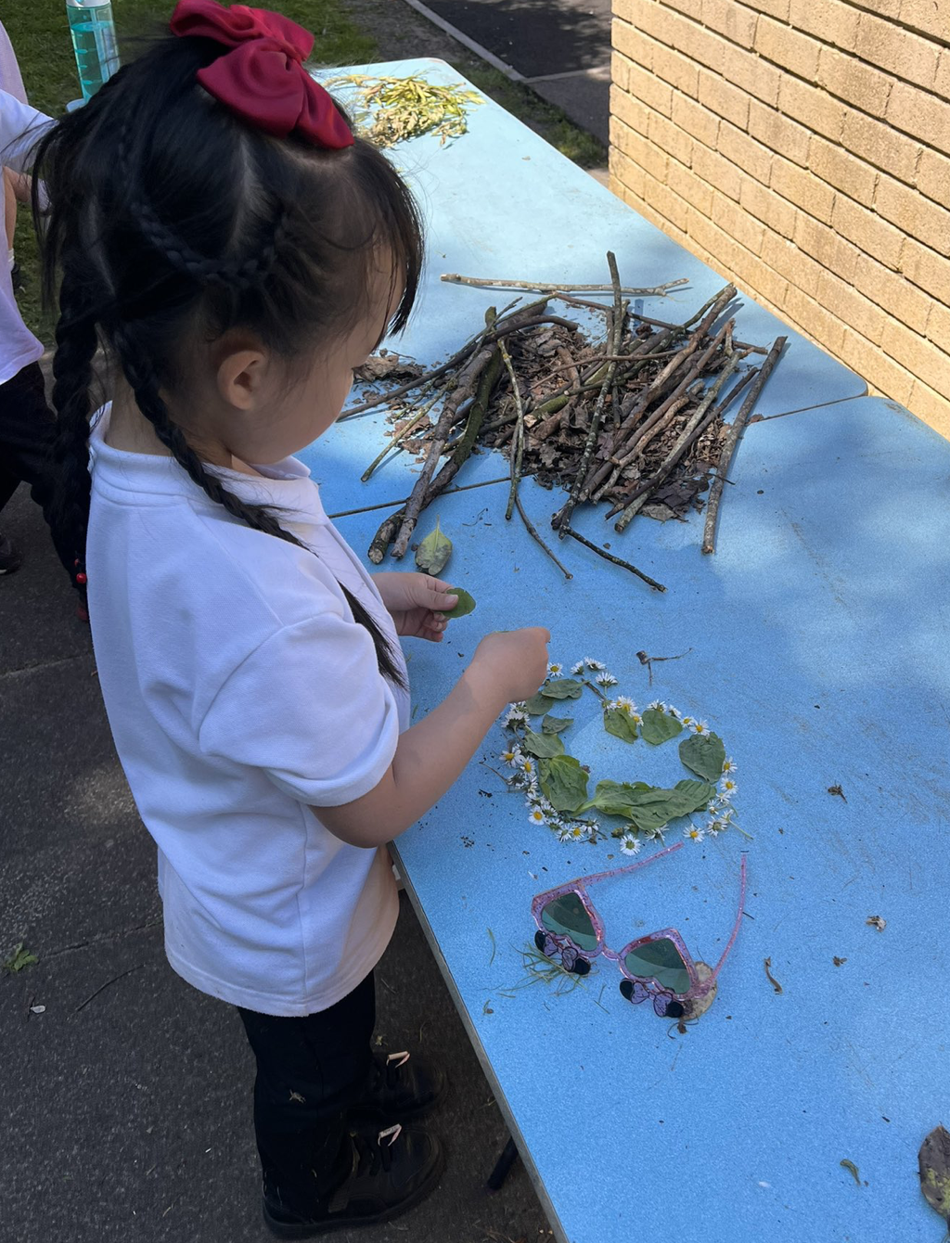
Reception Timetable

Slide 4
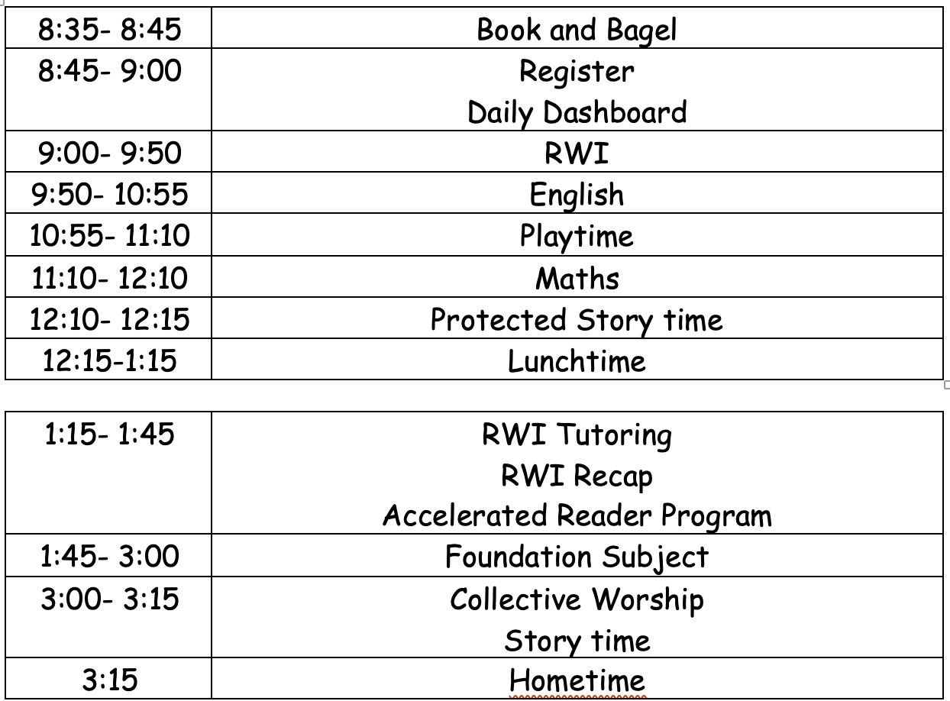
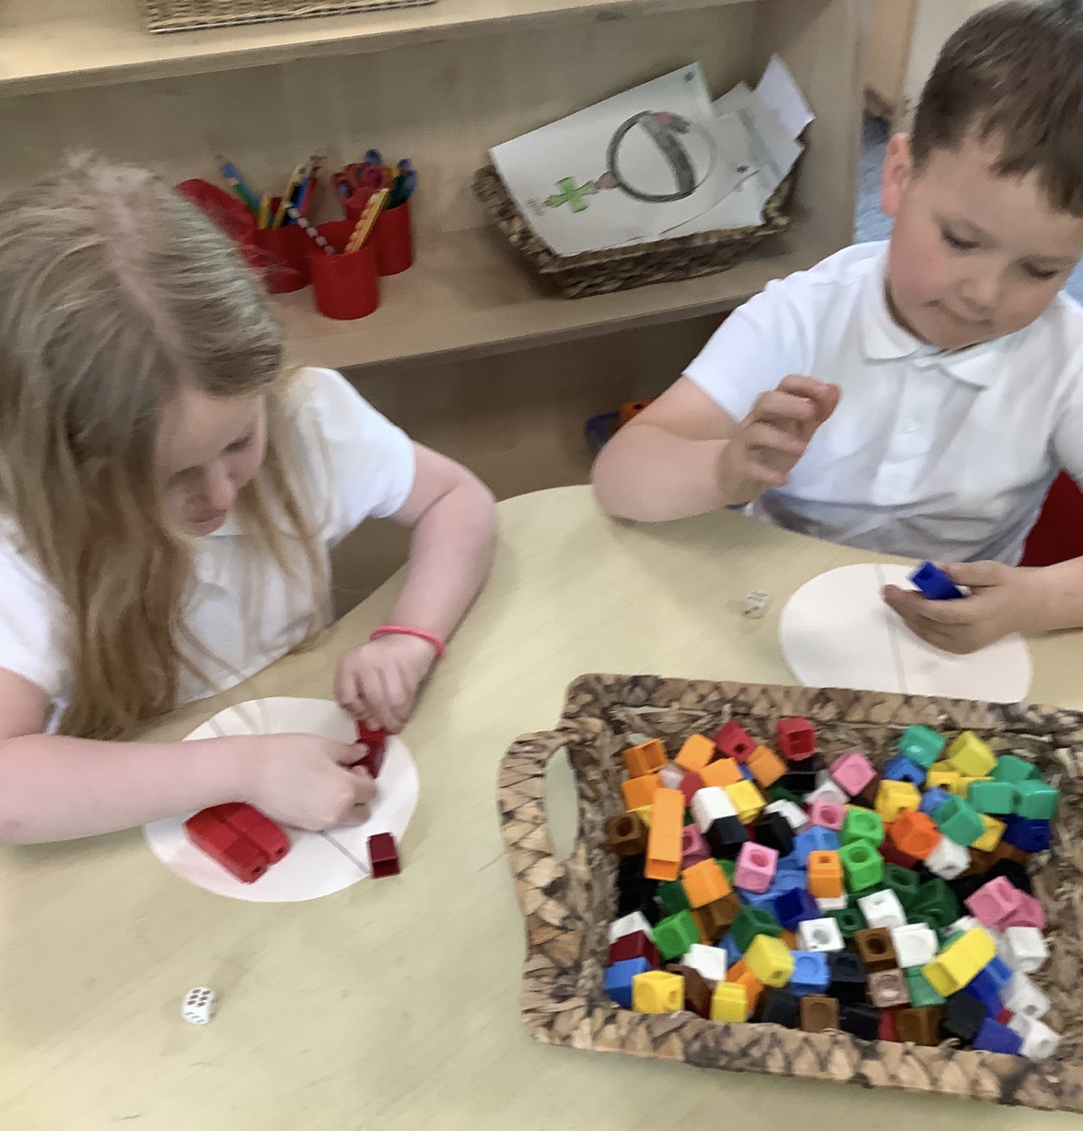
Key Stage 1 Timetable

